Slide 1
Skills Integration Challenge
Packet Tracer

Slide 2
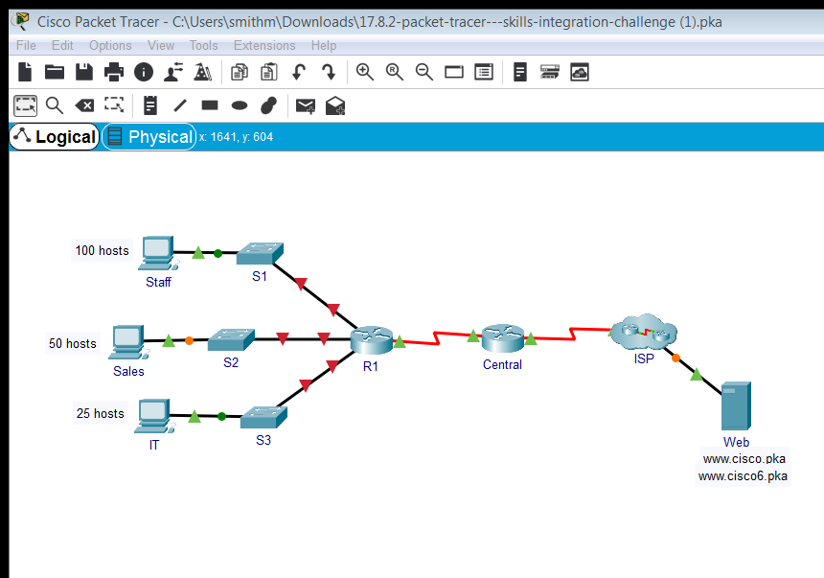

Slide 3
Subnetting
Supplied 192.168.0.0/24
/24 leaves 8 bits = 256 addresses or 254 hosts
/25 leaves 7 bits = 128 addresses or 126 hosts
/26 leaves 6 bits = 64 addresses or 62 hosts
/27 leaves 5 bits = 32 addresses or 30 hosts
/28 leaves 4 bits = 16 addresses or 14 hosts
/29 leaves 3 bits = 8 addresses or 6 hosts
/30 leaves 2 bits = 4 addresses or 2 hosts

Slide 4
Subnetting
Start, 192.168.0.0/24
Largest Subnet : Staff 100 hosts.
/25 leaves 7 bits = 128 addresses or 126 hosts
Subnet 192.168.0.0/24 into two /25 subnets
192.168.0.0/25
192.168.0.128/25
Assign 192.168.0.0/25 subnet to Staff LAN

Slide 5
Subnetting
Remaining, 192.168.0.128/25
Next Largest Subnet : Sales 50 hosts.
/26 leaves 6 bits = 64 addresses or 62 hosts
Subnet 192.168.0.128/25 into two /26 subnets
192.168.0.128/26
192.168.0.192/26
Assign 192.168.0.128/26 subnet to Sales LAN

Slide 6
Subnetting
Remaining, 192.168.0.192/26
Next Largest Subnet : IT 25 hosts.
/27 leaves 5 bits = 32 addresses or 30 hosts
Subnet 192.168.0.192/26 into two /27 subnets
192.168.0.192/27
192.168.0.224/27
Assign 192.168.0.192/27 subnet to IT LAN
Assign 192.168.0.224/27 subnet to Guest LAN

Slide 7
Basic Planning
Default-Gateway 1st host address in network range
Computer 2nd host address in network range
Switch SVI address last host address in network range

Slide 8
Staff LAN
Network Address: 192.168.0.0/25
Broadcast Address: 192.168.0.127/25
1st host: 192.168.0.1/25
2nd host: 192.168.0.2/25
Last host: 192.168.0.126/25

Slide 9
Sales LAN
Network Address: 192.168.0.128/26
Broadcast Address: 192.168.0.191/26
1st host: 192.168.0.129/26
2nd host: 192.168.0.130/26
Last host: 192.168.0.190/26

Slide 10
IT LAN
Network Address: 192.168.0.192/27
Broadcast Address: 192.168.0.223/27
1st host: 192.168.0.193/27
2nd host: 192.168.0.194/27
Last host: 192.168.0.222/27

Slide 11
Staff LAN
R1 G0/0 192.168.0.1 255.255.255.128
S1 192.168.0.126 255.255.255.128
Default-Gateway 192.168.0.1
Computer 192.168.0.2 255.255.255.128

Slide 12
Sales LAN
R1 G0/1 192.168.0.129 255.255.255.192
S2 192.168.0.190 255.255.255.192
Default-Gateway 192.168.0.129
Computer 192.168.0.130 255.255.255.192

Slide 13
IT LAN
R1 G0/2 192.168.0.193 255.255.255.224
S3 192.168.0.222 255.255.255.224
Default-Gateway 192.168.0.193
Computer 192.168.0.194 255.255.255.224

Slide 15
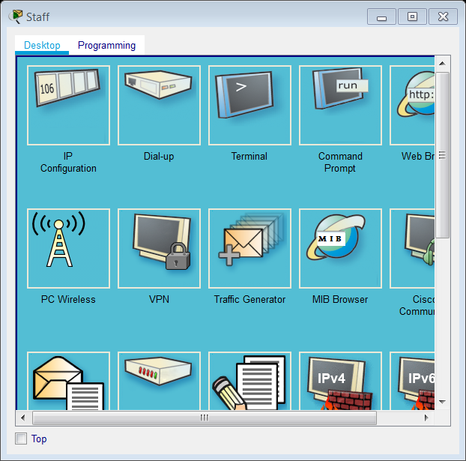
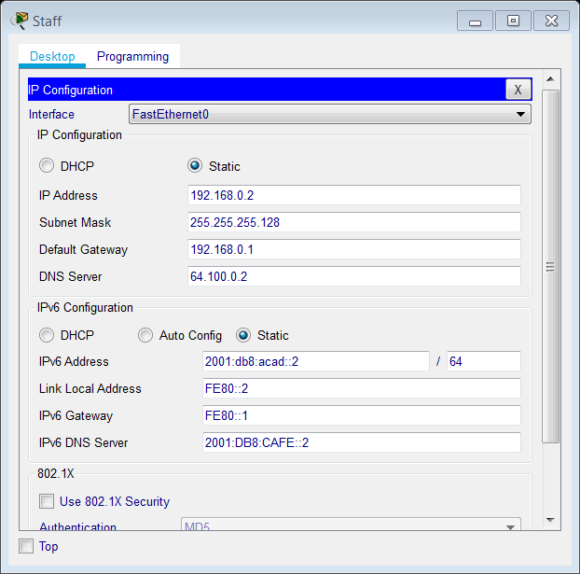

Slide 16



Slide 17
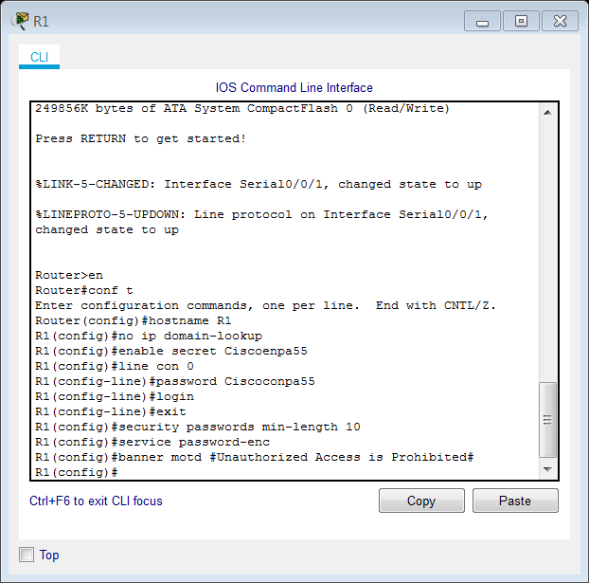
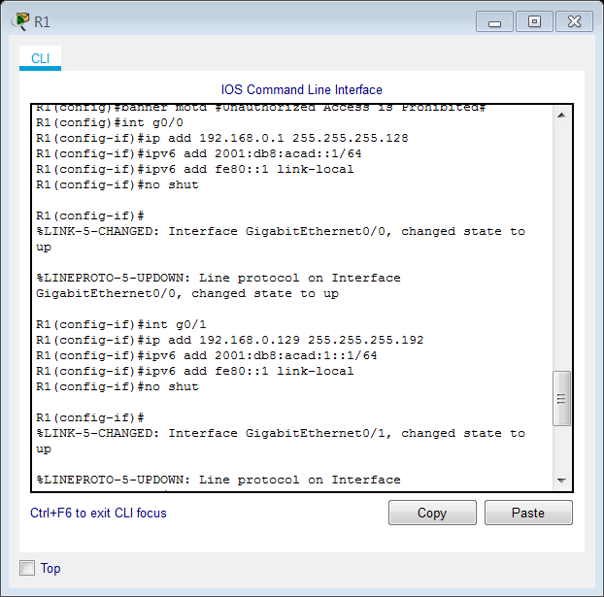

Slide 18
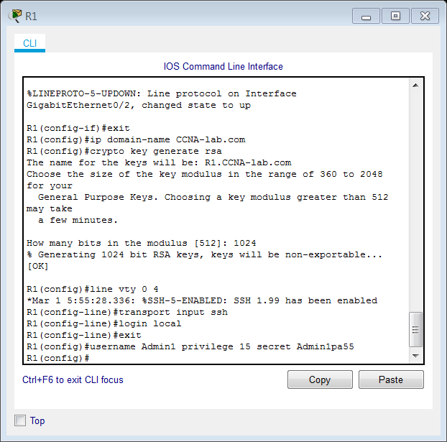
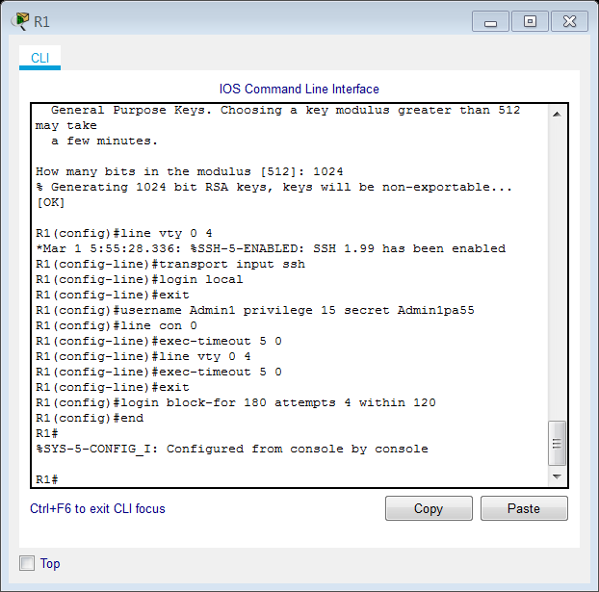

Slide 19
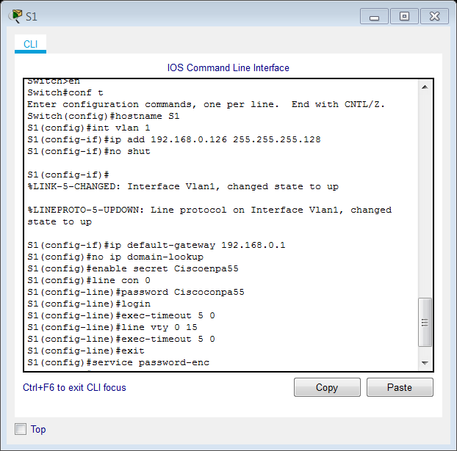

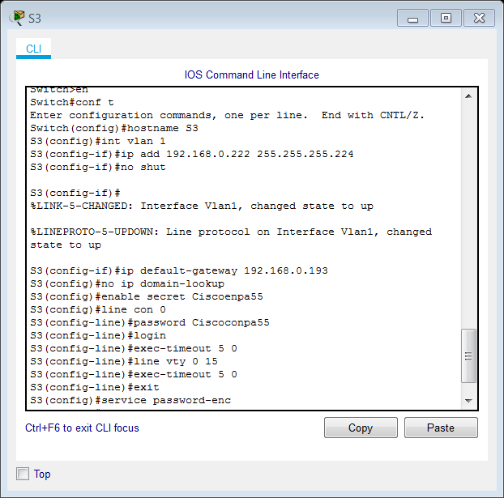

Slide 20
